Slide 1
Randomized Algorithms CS648
Talk by Group 8
Random walk and Electric networks

Slide 2
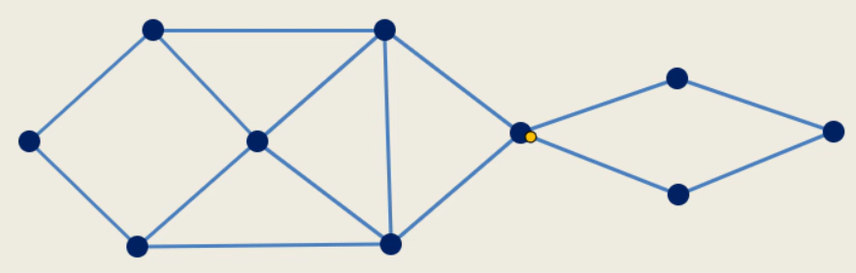
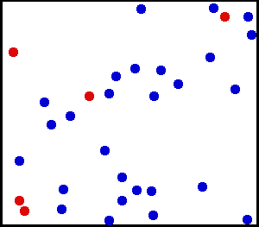

Random Walks
Applications
Brownian Motion
Stock Prices
Notes:
Brownian motion can be derived as a limiting case (continuous) of random walk.

Slide 3
Random walk and Electric Networks
RECAP OF

Slide 4
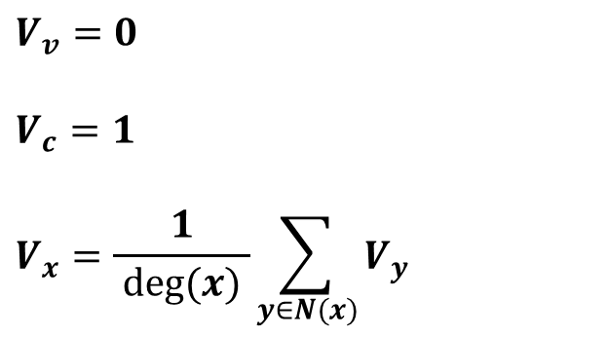
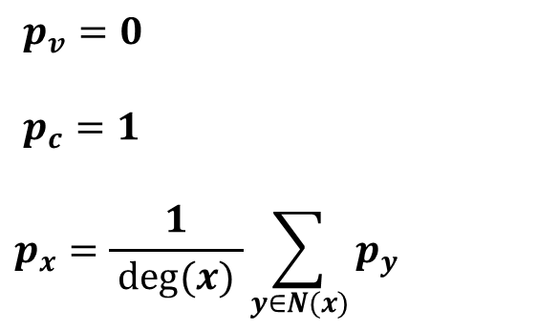
Drunkard Walk Problem
$$y$$
$$y$$
$$b$$
$$b$$
home
$$c$$
$$c$$
bar
$$u$$
$$x$$
$$u$$
$$v$$
$$x$$
$$v$$
$$g$$
$$g$$
$$d$$
$$d$$
$$a$$
$$a$$
$$z$$
$$z$$
Equivalent Circuit Schematic
$p_{v}=0$
$p_{c}=1$
$$p_{x}=\frac{1}{ deg(x) }\sum_{y∈N(x)}{p_{y}}$$
$$V_{v}=0$$
$$V_{c}=1$$
$$V_{x}=\frac{1}{ deg(x) }\sum_{y∈N(x)}{V_{y}}$$
Notes:
As discussed in Lecture 14 by Prof. Surender Baswana

Slide 5
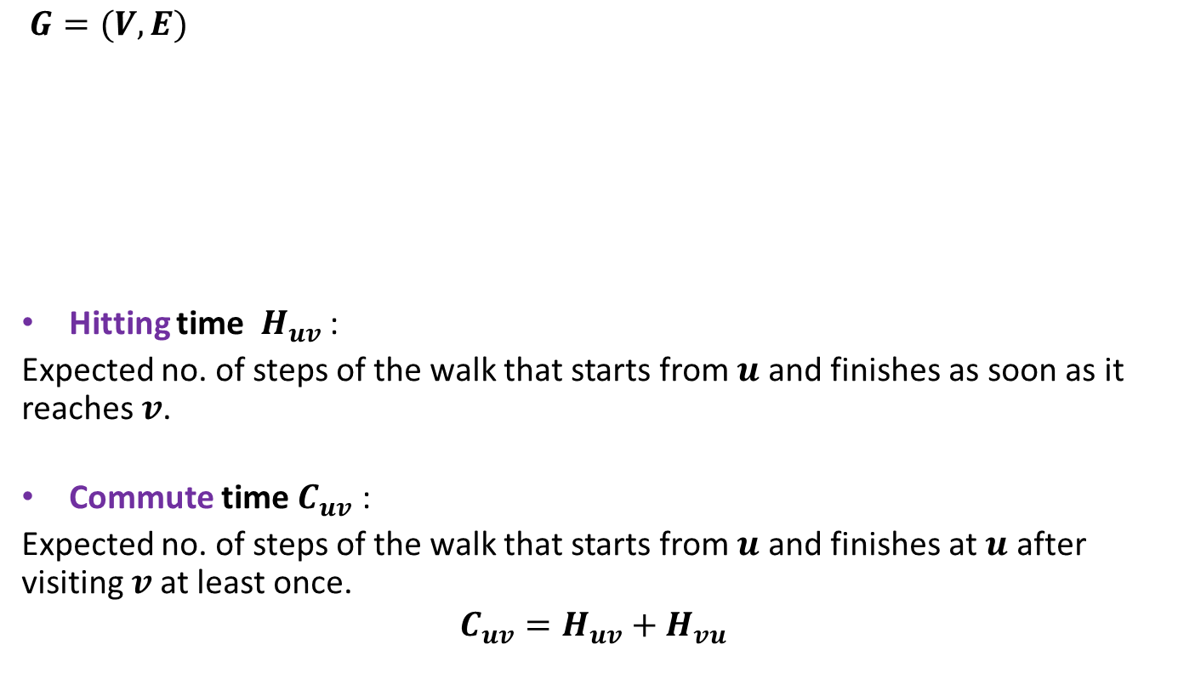
Notations
$$j$$
$$y$$
$$b$$
$G=(V,E)$
Hitting time $H_{uv}$ :
Expected no. of steps of the walk that starts from $u$ and finishes as soon as it reaches $v$.
Commute time $C_{uv}$ :
Expected no. of steps of the walk that starts from $u$ and finishes at $u$ after visiting $v$at least once.
$$C_{uv}=H_{uv}+H_{vu}$$
$$c$$
$$v$$
$$x$$
$$u$$
$$g$$
$$d$$
$$a$$
$$z$$

Slide 6

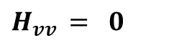
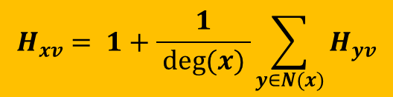
Expressing $H_{xv}$ through equations
$$y$$
$$b$$
$$c$$
$$v$$
$$x$$
$$u$$
$$g$$
$$d$$
$$a$$
$$z$$
$H_{vv }= 0$
$$H_{xv}=\frac{1}{deg(x)}\left(1+H_{bv}\right)+\frac{1}{deg(x)}\left(1+H_{av}\right)+\frac{1}{deg(x)}\left(1+H_{yv}\right)+\frac{1}{deg(x)}\left(1+H_{zv}\right)$$
$$H_{xv}= 1+\frac{1}{ deg(x) }\sum_{y∈N(x)}{H_{yv}}$$

Slide 7
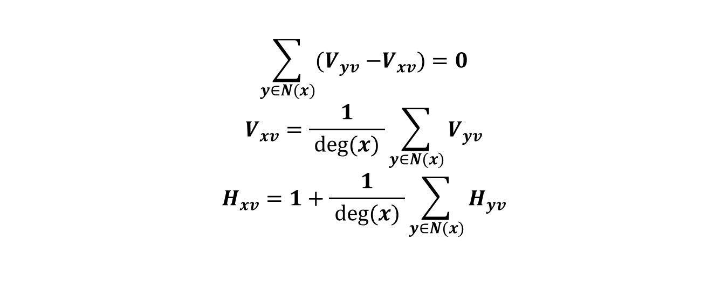

Expressing $H_{xv}$ through a circuit
$$y$$
$$b$$
$$c$$
$$v$$
$$x$$
$$u$$
$$g$$
$$d$$
$$a$$
$$z$$
$$\sum_{y∈N(x)}{{(V}_{yv} −V_{xv})=0}$$
$$V_{xv}=\frac{1}{ deg(x) }\sum_{y∈N(x)}{V_{yv}}$$
$$H_{xv}=1+\frac{1}{ deg(x) }\sum_{y∈N(x)}{H_{yv}}$$
$$KCL$$

Slide 8
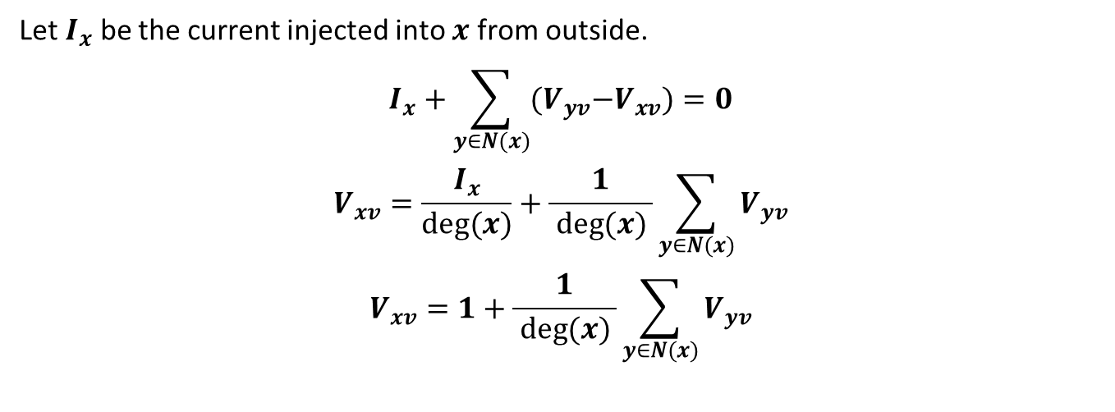
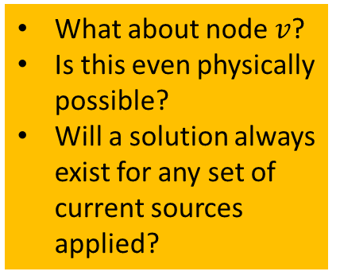
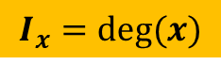
Expressing $H_{xv}$ through a circuit
$$y$$
$$b$$
$$c$$
$$v$$
$$x$$
$$u$$
$$g$$
❓
$$d$$
$$a$$
$$z$$
Let $I_{x}$ be the current injected into $x$ from outside.
$$I_{x}+\sum_{y∈N(x)}{{(V}_{yv}−V_{xv})}=0$$
$$V_{xv}=\frac{I_{x}}{deg(x)}+\frac{1}{ deg(x) }\sum_{y∈N(x)}{V_{yv}}$$
$$V_{xv}=1+\frac{1}{ deg(x) }\sum_{y∈N(x)}{V_{yv}}$$
What about node $v$?
Is this even physically possible?
Will a solution always exist for any set of current sources applied?
$$I_{x}=deg(x)$$

Slide 9
from here….
We pick up

Slide 10
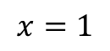
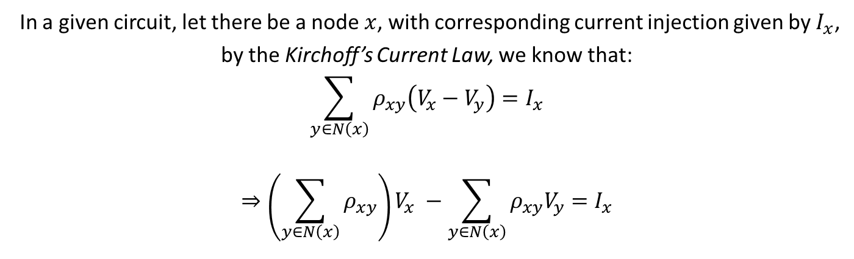
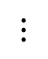
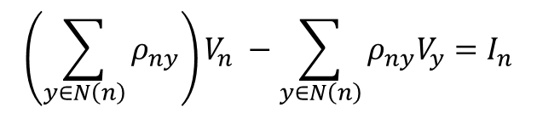
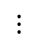
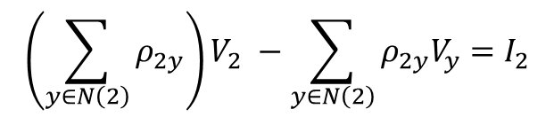
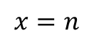
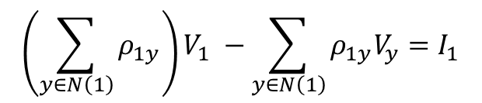
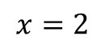
Kirchoff’s Current Law
In a given circuit, let there be a node $x$, with corresponding current injection given by $I_{x}$,
by the Kirchoff’s Current Law, we know that:
$$\sum_{y∈N\left(x\right)}{ρ_{xy}\left(V_{x}−V_{y}\right)}=I_{x}$$
$$⇒\left(\sum_{y∈N\left(x\right)}{ρ_{xy}}\right)V_{x} −\sum_{y∈N\left(x\right)}{ρ_{xy}V_{y}}=I_{x}$$
$$\left(\sum_{y∈N\left(1\right)}{ρ_{1y}}\right)V_{1} −\sum_{y∈N\left(1\right)}{ρ_{1y}V_{y}}=I_{1}$$
$$x=1$$
$$\left(\sum_{y∈N\left(2\right)}{ρ_{2y}}\right)V_{2} −\sum_{y∈N\left(2\right)}{ρ_{2y}V_{y}}=I_{2}$$
$$x=2$$
$$⋮$$
$$⋮$$
$$\left(\sum_{y∈N\left(n\right)}{ρ_{ny}}\right)V_{n} −\sum_{y∈N\left(n\right)}{ρ_{ny}V_{y}}=I_{n}$$
$$x=n$$
Notes:
Rho_(xy) is the conductivity of edge xy. It is interesting thing to note that here the sum of co-efficients is Zero!!

Slide 11
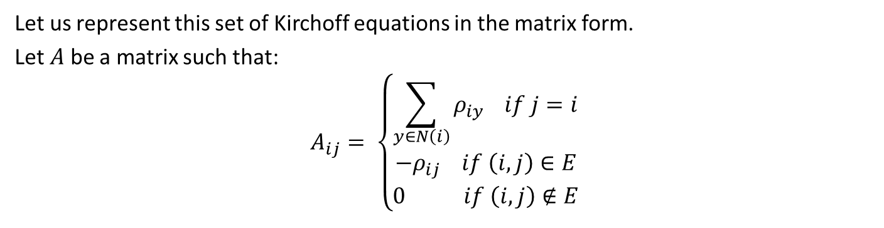
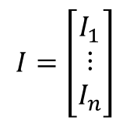
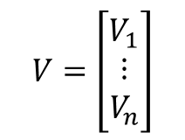
Kirchoff’s Current Law
Let us represent this set of Kirchoff equations in the matrix form.
Let $A$ be a matrix such that:
$$A_{ij}= \left\{\begin{aligned}\sum_{y∈N\left(i\right)}{ρ_{iy} } if j=i \\ −ρ_{ij} if \left(i, j\right)∈E \\ 0 if \left(i, j\right)∉E\end{aligned}\right.$$
$$V=\left[\begin{matrix}V_{1} \\ ⋮ \\ V_{n}\end{matrix}\right]$$
$$I=\left[\begin{matrix}I_{1} \\ ⋮ \\ I_{n}\end{matrix}\right]$$
So, the set of Kirchoff equations can be written as:
$$AV=I$$
Notes:
Note that A is symmetric

Slide 12
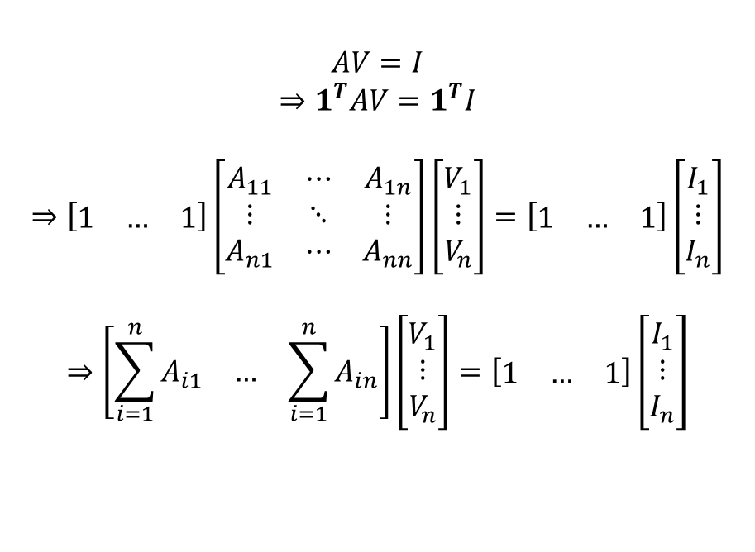
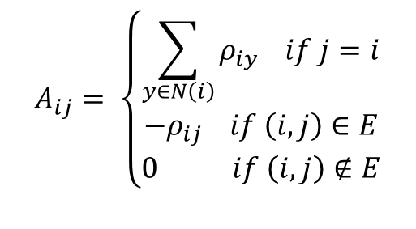
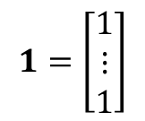
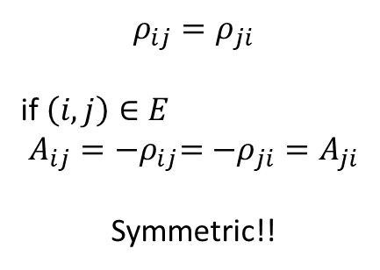
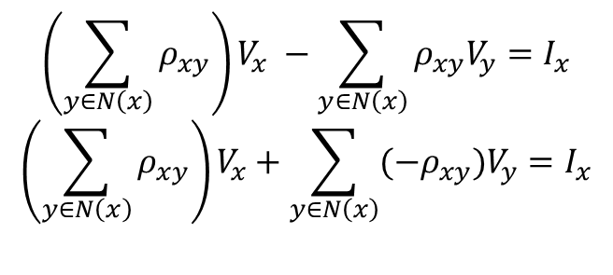
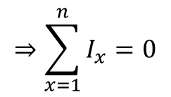
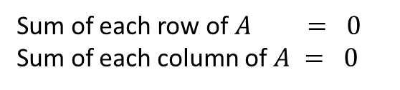
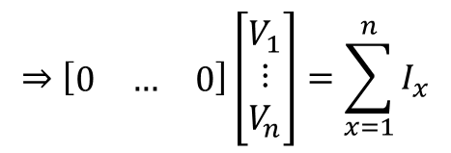
Kirchoff’s Current Law
$$A_{ij}= \left\{\begin{aligned}\sum_{y∈N\left(i\right)}{ρ_{iy} } if j=i \\ −ρ_{ij} if \left(i, j\right)∈E \\ 0 if \left(i, j\right)∉E\end{aligned}\right.$$
Sum of each row of $A = 0$
Sum of each column of $A = 0$
$$AV=I$$
$$⇒1^{T}AV=1^{T}I$$
$$⇒\left[\begin{matrix}1 & … & 1\end{matrix}\right]\left[\begin{matrix}A_{11} & ⋯ & A_{1n} \\ ⋮ & ⋱ & ⋮ \\ A_{n1} & ⋯ & A_{nn}\end{matrix}\right]\left[\begin{matrix}V_{1} \\ ⋮ \\ V_{n}\end{matrix}\right]=\left[\begin{matrix}1 & … & 1\end{matrix}\right]\left[\begin{matrix}I_{1} \\ ⋮ \\ I_{n}\end{matrix}\right]$$
$$⇒\left[\begin{matrix}\sum_{i=1}^{n}{A_{i1}} & … & \sum_{i=1}^{n}{A_{in}}\end{matrix}\right]\left[\begin{matrix}V_{1} \\ ⋮ \\ V_{n}\end{matrix}\right]=\left[\begin{matrix}1 & … & 1\end{matrix}\right]\left[\begin{matrix}I_{1} \\ ⋮ \\ I_{n}\end{matrix}\right]$$
$$ρ_{ij}=ρ_{ji}$$
if $\left(i, j\right)∈E$
$$A_{ij}={−ρ}_{ij}=−ρ_{ji}=A_{ji}$$
Symmetric!!
$$\left(\sum_{y∈N\left(x\right)}{ρ_{xy}}\right)V_{x} −\sum_{y∈N\left(x\right)}{ρ_{xy}V_{y}}=I_{x}$$
$$\left(\sum_{y∈N\left(x\right)}{ρ_{xy}}\right)V_{x}+\sum_{y∈N\left(x\right)}{(−ρ_{xy})V_{y}}=I_{x}$$
Let
$$1=\left[\begin{matrix}1 \\ ⋮ \\ 1\end{matrix}\right]$$
So my net current injection has to be zero for a solution to exist!!
$$⇒\left[\begin{matrix}0 & … & 0\end{matrix}\right]\left[\begin{matrix}V_{1} \\ ⋮ \\ V_{n}\end{matrix}\right]=\sum_{x=1}^{n}{I_{x}}$$
$$⇒\sum_{x=1}^{n}{I_{x}}=0$$
It is necessary, but
is it sufficient? 🤔

Slide 13
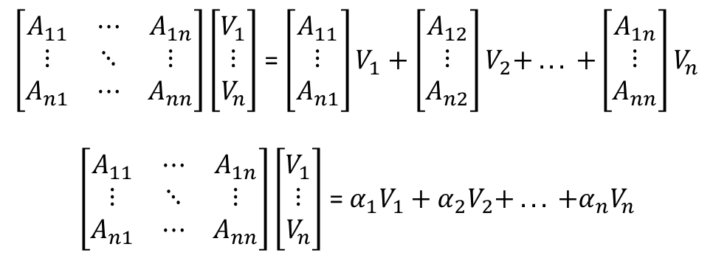
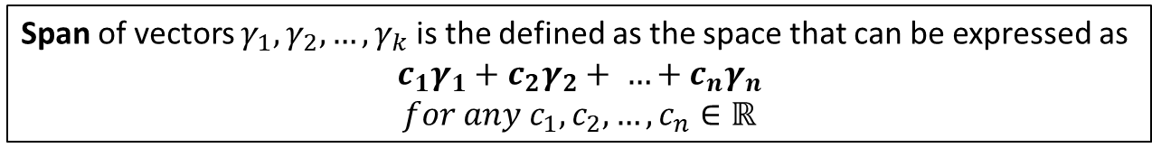
Existence
$\left[\begin{matrix}A_{11} & ⋯ & A_{1n} \\ ⋮ & ⋱ & ⋮ \\ A_{n1} & ⋯ & A_{nn}\end{matrix}\right]\left[\begin{matrix}V_{1} \\ ⋮ \\ V_{n}\end{matrix}\right]$ = $\left[\begin{matrix}A_{11} \\ ⋮ \\ A_{n1}\end{matrix}\right]V_{1}+\left[\begin{matrix}A_{12} \\ ⋮ \\ A_{n2}\end{matrix}\right]V_{2}+ . .. +\left[\begin{matrix}A_{1n} \\ ⋮ \\ A_{nn}\end{matrix}\right]V_{n}$
$\left[\begin{matrix}A_{11} & ⋯ & A_{1n} \\ ⋮ & ⋱ & ⋮ \\ A_{n1} & ⋯ & A_{nn}\end{matrix}\right]\left[\begin{matrix}V_{1} \\ ⋮ \\ V_{n}\end{matrix}\right]$ = $α_{1}V_{1}+α_{2}V_{2}+ . .. +α_{n}V_{n}$
Span of vectors $γ_{1}, γ_{2},…, γ_{k}$ is the defined as the space that can be expressed as
$$c_{1}γ_{1}+c_{2}γ_{2}+ …+c_{n}γ_{n}$$
$$for any c_{1},c_{2},…, c_{n}∈ℝ$$
Thus, if the current injection vector lies in the column space of A,
a corresponding voltage solution must exist.
Notes:
Hence, if the current injection vector lies in the span of column vectors of A, then there must exist a set of voltages, such that a solution exists.

Slide 14
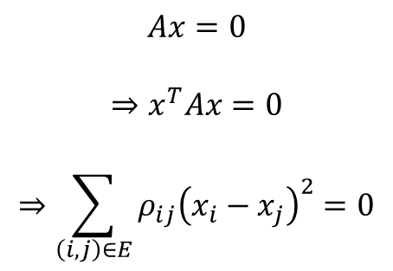
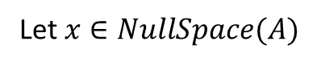
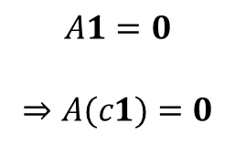
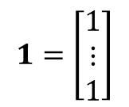
Existence
The null space (or kernel) of an $n×n$ matrix $M$ is the set of all vectors $x∈ℝ^{n}$ such that:
$$Mx=0$$
$$1=\left[\begin{matrix}1 \\ ⋮ \\ 1\end{matrix}\right]$$
$$A1=0$$
$$⇒A(c1)=0$$
Let $x∈NullSpace(A)$
$$Ax=0$$
$$⇒x^{T}Ax=0$$
$$⇒\sum_{\left(i, j\right)∈E}{ρ_{ij}{\left(x_{i}−x_{j}\right)}^{2}}=0$$
Thus, Null Space of A is exactly the set of column vectors $c1$

Slide 15
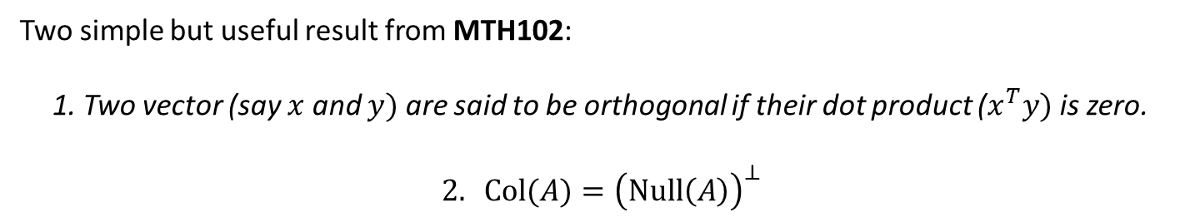
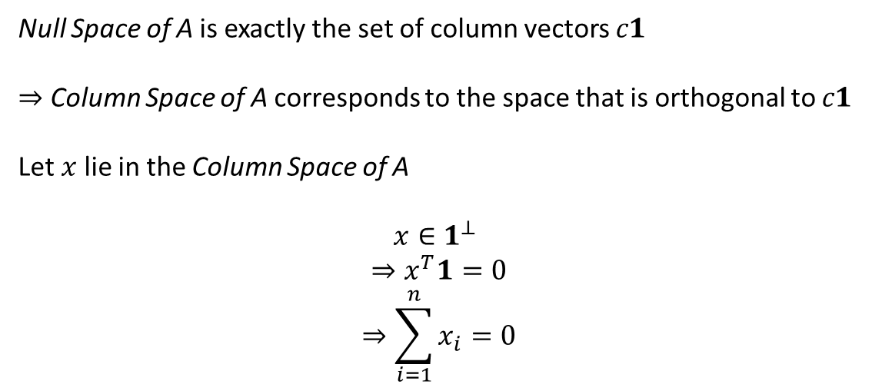
Existence
Two simple but useful result from MTH102:
1. Two vector (say $x$ and $y)$ are said to be orthogonal if their dot product ($x^{T}y)$ is zero.
$$2. Col(A)={\left(Null\left(A\right)\right)}^{⊥}$$
Null Space of A is exactly the set of column vectors $c1$
$⇒$ Column Space of A corresponds to the space that is orthogonal to $c1$
Let $x$ lie in the Column Space of A
$x∈1^{⊥}$
$$⇒x^{T}1=0$$
$$⇒\sum_{i=1}^{n}{x_{i}=0}$$
Thus, necessary and sufficient!! ☺

Slide 16
Superposition of Current Flow A tool for commute time

Slide 17
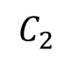
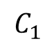

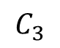
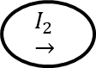
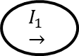


Superposition Theorem
(Focusing particularly on current sources)
$$+$$
$$=$$
$$I_{1}→$$
$$I_{1}→$$
$$I_{2}→$$
$$I_{2}→$$
$$C_{1}$$
$$C_{2}$$
$$C_{3}$$
Something to
remember
for later ☺
$C_{1}$ and $C_{2}$ can be superposed in order to obtain $C_{3}$
$$ΔV_{1}+ΔV_{2}=ΔV_{3}$$
Notes:
The voltage across (or current through) an element in a linear circuit is the
algebraic sum of the voltages across (or currents through) that element due to
each independent source acting alone.

Slide 18
Reversibility of Current Flow A tool for commute time

Slide 19
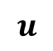
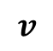
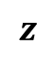
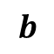
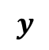
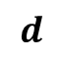




Reversibility
Question:
What happens to the voltages when the current injections are reversed?
$$b$$
$$y$$
$$c$$
$$v$$
$$u$$
$$x$$
$$g$$
$$d$$
$$a$$
$$z$$
$$C_{1}$$

Slide 20










Reversibility
Question:
What happens to the voltages when the current injections are reversed?
$$b$$
$$y$$
$$c$$
$$v$$
$$u$$
$$x$$
$$g$$
$$d$$
$$a$$
$$z$$
$$C_{2}$$

Slide 21


Reversibility
$$b$$
$$y$$
$$c$$
$$v$$
$$u$$
$$C_{1}$$
$$x$$
$$g$$
$$d$$
$$a$$
$$z$$
+
$$b$$
$$y$$
$$c$$
$$v$$
$$u$$
$$C_{2}$$
$$x$$
$$g$$
$$d$$
$$a$$
$$z$$

Slide 22

Reversibility
$$y$$
$$b$$
$$y$$
$$b$$
$$c$$
$$c$$
$$u$$
$$v$$
$$u$$
$$v$$
$$g$$
$$x$$
$$g$$
$$x$$
$$d$$
$$d$$
$$a$$
$$a$$
$$z$$
$$z$$
$$C_{1}+C_{2}$$

Slide 23




Reversibility
$$C_{3}=C_{1}+C_{2}$$
$$b$$
$$y$$
$$c$$
$$v$$
$$u$$
$$x$$
$$g$$
$$d$$
$$a$$
$$z$$
$$ΔV_{3}=0$$
$$ΔV_{1}+ΔV_{2}=0$$
$$ΔV_{2}=−ΔV_{1}$$
Notes:
Delta V means the potential difference configuration corresponding to that circuit.

Slide 24
Our Arsenal is Ready!!!
Reversibility of current flow
Superposition of current flow
Uniqueness of current flow

Slide 25











Hitting time & Commute time
$$b$$
$$y$$
$$c$$
$$deg⁡(b)$$
$$deg⁡(y)$$
$$u$$
$$v$$
$$deg⁡(c)$$
$$g$$
$$x$$
$$deg⁡(x)$$
$$deg⁡(u)$$
$$d$$
$$deg⁡(g)$$
$$2m −deg⁡(v)$$
$$a$$
$$z$$
$$deg⁡(d)$$
$$deg⁡(a)$$
$$deg⁡(z)$$
We have already proved that$H_{uv}=V_{uv}$ in the above circuit. But how to simplify $V_{uv}$?
🤔
Instead of Hitting Time, lets now try with Commute Time
Notes:
Solving Hitting Time:
Will breaking it down using superposition help?
Not really ☹
Ponder Why?

Slide 26




















Circuit for which $V_{uv}=H_{uv}$
$$b$$
$$y$$
$$c$$
$$deg⁡(b)$$
$$deg⁡(y)$$
$$u$$
$$v$$
$$deg⁡(c)$$
$$g$$
$$x$$
$$deg⁡(x)$$
$$deg⁡(u)$$
$$d$$
$$deg⁡(g)$$
$$2m −deg⁡(v)$$
$$a$$
$$z$$
$$deg⁡(d)$$
$$deg⁡(a)$$
$$deg⁡(z)$$
Circuit for which${V′}_{vu}=H_{vu}$
$$b$$
$$y$$
$$c$$
$$deg⁡(b)$$
$$deg⁡(y)$$
$$u$$
$$v$$
$$deg⁡(c)$$
$$g$$
$$x$$
$$deg⁡(v)$$
$$deg⁡(x)$$
$$d$$
$$deg⁡(g)$$
$$2m −deg⁡(u)$$
$$a$$
$$z$$
$$deg⁡(d)$$
$$deg⁡(a)$$
$$deg⁡(z)$$

Slide 27


$$V_{uv}=V_{u} −V_{v}=H_{uv}$$
${V′}_{vu}={V′}_{v} −{V′}_{u}=H_{vu}$
Superposition?
Notes:
To get the Commute Time,
We need to add these two. But How?

Slide 28


$$V_{uv}=V_{u} −V_{v}=H_{uv}$$
${V′}_{vu}={V′}_{v} −{V^{′}}_{u}=H_{vu}$
$$\left(V_{u}+V_{u}^{′}\right)−\left(V_{v}−V_{v}^{′}\right)=H_{uv}−H_{vu}$$
Insight:
$H_{uv}$ is $u −v$
$H_{vu}$ is $v −u$
Notes:
How do we add these two?
Will superposing the two circuits directly help?

Slide 29


The two major insights we have now are:
The current injected at each of the nodes is same for the above two circuits, except for Node $u$ and Node $v$
and
$H_{uv}$ is $u −v$
$H_{vu}$ is $v −u$
🤔
Here, we use the next tool in our Arsenal! Reversibility

Slide 30
Circuit for which $V_{uv}=H_{uv}$
$$b$$
$$y$$
$$c$$
$$deg⁡(b)$$
$$deg⁡(y)$$
$$u$$
$$v$$
$$deg⁡(c)$$
$$g$$
$$x$$
$$deg⁡(x)$$
$$deg⁡(u)$$
$$d$$
$$deg⁡(g)$$
$$2m −deg⁡(v)$$
$$a$$
$$z$$
$$deg⁡(d)$$
$$deg⁡(a)$$
$$deg⁡(z)$$
Circuit for which${V′}_{vu}=H_{vu}$
$$b$$
$$y$$
$$c$$
$$deg⁡(b)$$
$$deg⁡(y)$$
$$u$$
$$v$$
$$deg⁡(c)$$
$$g$$
$$x$$
$$deg⁡(v)$$
$$deg⁡(x)$$
$$d$$
$$deg⁡(g)$$
$$2m −deg⁡(u)$$
$$a$$
$$z$$
$$deg⁡(d)$$
$$deg⁡(a)$$
$$deg⁡(z)$$

Slide 31












Circuit for which $V_{uv}=H_{uv}$
$$b$$
$$y$$
$$c$$
$$deg⁡(b)$$
$$deg⁡(y)$$
$$u$$
$$v$$
$$deg⁡(c)$$
$$g$$
$$x$$
$$deg⁡(x)$$
$$deg⁡(u)$$
$$d$$
$$deg⁡(g)$$
$$2m −deg⁡(v)$$
$$a$$
$$z$$
$$deg⁡(d)$$
$$deg⁡(a)$$
$$deg⁡(z)$$
$$−H_{vu}$$
$$⇒V_{uv}^{′}=H_{vu}$$
Circuit for which${V′}_{vu}=H_{vu}$
$$b$$
$$y$$
$$c$$
$$deg⁡(b)$$
$$deg⁡(y)$$
$$u$$
$$v$$
$$deg⁡(c)$$
$$g$$
$$x$$
$$deg⁡(v)$$
$$deg⁡(x)$$
$$d$$
$$deg⁡(g)$$
$$2m −deg⁡(u)$$
$$a$$
$$z$$
$$deg⁡(d)$$
$$deg⁡(a)$$
$$deg⁡(z)$$
Notes:
Are we ready to superpose?

Slide 32









































$$b$$
$$y$$
$$c$$
$$deg⁡(b)$$
$$deg⁡(y)$$
$$u$$
$$v$$
$$deg⁡(c)$$
$$g$$
$$x$$
$$deg⁡(x)$$
$$deg⁡(u)$$
$$d$$
$$deg⁡(g)$$
$$2m −deg⁡(v)$$
$$a$$
$$z$$
$$deg⁡(d)$$
$$deg⁡(a)$$
$$deg⁡(z)$$
$$+$$
$$b$$
$$y$$
$$c$$
$$deg⁡(b)$$
$$deg⁡(y)$$
$$u$$
$$v$$
$$deg⁡(c)$$
$$g$$
$$x$$
$$deg⁡(v)$$
$$deg⁡(x)$$
$$d$$
$$deg⁡(g)$$
$$2m −deg⁡(u)$$
$$a$$
$$z$$
$$deg⁡(d)$$
$$deg⁡(a)$$
$$deg⁡(z)$$

Slide 33




















$$y$$
$$b$$
$$y$$
$$b$$
$$c$$
$$c$$
$$deg⁡(y)$$
$$deg⁡(b)$$
$$deg⁡(y)$$
$$deg⁡(b)$$
$$u$$
$$v$$
$$u$$
$$v$$
$$g$$
$$deg⁡(c)$$
$$g$$
$$x$$
$$deg⁡(c)$$
$$x$$
$$deg⁡(u)$$
$$deg⁡(g)$$
$$deg⁡(x)$$
$$deg⁡(g)$$
$$deg⁡(v)$$
$$deg⁡(x)$$
$$d$$
$$2m −deg⁡(u)$$
$$d$$
$$a$$
$$a$$
$$z$$
$$2m −deg⁡(v)$$
$$z$$
$$deg⁡(d)$$
$$deg⁡(d)$$
$$deg⁡(z)$$
$$deg⁡(a)$$
$$deg⁡(z)$$
$$deg⁡(a)$$

Slide 34






$$v$$
$$u$$
$$2m −deg⁡(u)$$
$$+ deg⁡(u)$$
$$2m −deg⁡(v)$$
$$+ deg⁡(v)$$
$$2m$$
$$2m$$

Slide 35






$$v$$
$$u$$
$$2m$$
$$2m$$
$$V_{uv}^{′′}=V_{uv}+V_{uv}^{′}=H_{uv}+H_{vu}=C_{uv}$$
Hence, this new circuit gives us the Commute Time of the graph!!
$${V′′}_{uv}=2mR_{uv}$$
$$C_{uv}=2mR_{uv}$$
😀
Notes:
V’’ is the voltage corresponding to this new circuit formed after superposition.

Slide 36

Empirical Analysis – Commute Time
Notes:
Minimum Commute Time = 2 * shortest path

Slide 37

Distribution of Commute Times
Notes:
Shortest matches in empirical

Slide 38

Surviving walkers at a given time
Notes:
Appears to be inverse-exponential let’s take log

Slide 39


Distribution of surviving walkers
$$P\left(C_{uv} >t\right)∝e^{−\frac{t}{τ_{uv}}}$$
Notes:
Deviation bounded by inverse exponential

Slide 40
Only Equational Equivalence or Even More?
Notes:
Seen Drunkard, Hitting Time and Commute Time
Any deeper connection or just luck?

Slide 41





Same Equations governing various phenomenon
$$ΔV=I⋅R$$
Fluid Flow
Heat Transfer
$$ΔP=Q⋅\frac{8ηL}{{πR}^{4}}$$
$ΔT= \dot{Q}⋅\frac{L}{κπR^{2}}$
Notes:
Observe world around, similar to electric equations
Microscopic Random Motion
Macroscopic Electric Equations

Slide 42


Electrical Circuits and Random Motion
Random Motion of Electrons
Drift Velocity
Notes:
The motion of electrons can be modelled as following a straight path until they collide with the metallic lattice. After which they are bounce back in a random direction.
In the presence of a electric field, due to acceleration, electrons develop a effective drift velocity in the direction opposite to the electric field. This velocity is smaller than the velocity of electrons and constitutes current.

Slide 43


Army of Random Walkers via a problem
Problem: Given an undirected graph $G=(V,E)$ on $m$ edges,
a node $u$ on which at every time step on new random walker is added,
a node $v$ on which any random walker arriving is killed,
for all nodes determine, the expected number of walkers after a long time.
Notes:
Explore intuitive connection between electric circuits and multiple random walkers via problem

Slide 44


A simpler variant
Problem: Given an undirected graph $G=(V,E)$ on $m$ edges,
with $N$independent random walkers.
Determine $η_{u }$, the expected number of walkers on node $u$.
Notes:
Simpler variant to set framework for harder problem

Slide 45












Would an Army of Random Walkers have similar dynamics?
$$b$$
$$y$$
$$z$$
$$v$$
$$u$$
$$x$$
$$g$$
$$d$$
$$a$$
$$c$$
Focus on a single time-step and a single vertex
$$η_{u}= \frac{η_{y}}{deg⁡(y)}+ \frac{η_{z}}{deg⁡(z)}+ \frac{η_{c}}{deg⁡(c)}+ \frac{η_{d}}{deg⁡(d)}$$
$$η_{x}=\sum_{y∈N(x)}{\frac{η_{y}}{deg⁡(y)}}$$
Notes:
All on u leave it
Add contributions from neighbours

Slide 46


Dynamics of Army and The Challenge
Army Equations
$$η_{x}=\sum_{y∈N(x)}{\frac{η_{y}}{deg⁡(y)}}$$
Circuit Equations
$$V_{x}=\sum_{y∈N(x)}{\frac{V_{y}}{deg⁡(x)}}$$
Notes:
Not exactly equal
How to proceed?

Slide 47






Overcoming the Challenge
$$ψ_{x}= \frac{η_{x}}{deg⁡(x)}$$
$$η_{x}=\sum_{y∈N(x)}{\frac{η_{y}}{deg⁡(y)}}$$
$$ψ_{x}\deg\left(x\right)=\sum_{y∈N(x)}{\frac{ψ_{y}deg⁡(y)}{deg⁡(y)}}$$
$$ψ_{x}=\sum_{y∈N(x)}{\frac{ψ_{y}}{deg⁡(x)}}$$
$$V_{x}=\sum_{y∈N(x)}{\frac{V_{y}}{deg⁡(x)}}$$
Notes:
Degree term causing issue
Now we get similar

Slide 48


An Amazing Outcome
$$u$$
Number of random walkers crossing an edge
$$\frac{η_{u}}{deg⁡(u)} − \frac{η_{v}}{\deg\left(v\right)}$$
$$ψ_{u}−ψ_{v}$$
$$V_{u}−V_{v}$$
$$ΔV_{uv}$$
$$I_{uv}$$
$$v$$
is proportional to the current flowing through the edge!

Slide 49

Result: Given an undirected graph $G=(V,E)$ on $m$ edges,
a node $u$ on which at every time step on new random walker is added,
a node $v$ on which any random walker arriving is killed.
There exists an equivalent electrical circuit with the voltage of a node in the circuit equal to the expected number of walkers.
Exercise: Determine the circuit based on the insights from the discussion ☺

Slide 50
Thank YOU!

